Slide 1
OIL AND GOVERNANCE
State-owned Enterprises and the World Energy Supply
GEMBA Woodlands 1
GENB 7A97

Slide 2
Political economy of Expropriation and privatization in the oil sector
70% of the worlds oil reserves and 68% gas -NOC’s
Studies
Difference between NOCs and
independent, private oil companies
Some World Wide – Saudi Aramco and Statoil
Russia World largest gas company – Ukraine gas wars
Establishment of nationalized private oil companies in face of weak performance
Name – called many but “National Oil Company” NOC best for text

Slide 3
Goal of state leaders -Retain Power Decisions- to enhance ability to retain power
Things change – Hugo Chavez – Venezuela – PDVSA
Senegal – Oil production secondary
Structured by leaders incentives and constraints Fewer checks and balances before 1980
History:
Austria - 1908 Seven Sisters
Argentina – 1922 Near – total control
France – 1924 then
Italy – ENI – 1926 Sonatrach
Civic holiday - Mexico – Pemex – 1938 Aramco
Leader ship - IRAN – NIOC – 1948 Statoil
Brazil Petronas – 1953 Petronas
India ONGO – 1956 Kuwait

Slide 4
Well developed literature on countries decisions
1970 IOCS 85% access
1980 IOCS 12% by 2030 – 80% - NOC’s
List about same as was 1970’s
Factors
SOC – state owned enter prices - SOC
NOC – National Oil Companies - NOC
Incentives for expropriation – will review
Institutional constraints – each country different
Why? Foreign ownership - threat to security
NOC – Convenient for political patronage
1990’s SOC – big money losers. NOC – generated huge profits
If you want world bank 2008 – you will have NOC’s engage in a wide array of non commercial statistic rankings different from this text

Slide 5
These Studies
4 Types of decisions:
Operatorship – does NOC operates its own fields
Resources – Focus on low-risks or invest in development
Geography – Solely at home or overseas – Statoil
Political – How does NOC create political assets needed
Independent Variables:
-Factors external to NOC
-Regulation
-Quality institutions w/i state (Ch. 3 looks at administrative capacity)
-”Easy” oil – geological challenge
Note: Rice did a study of 12 countries.

Slide 6
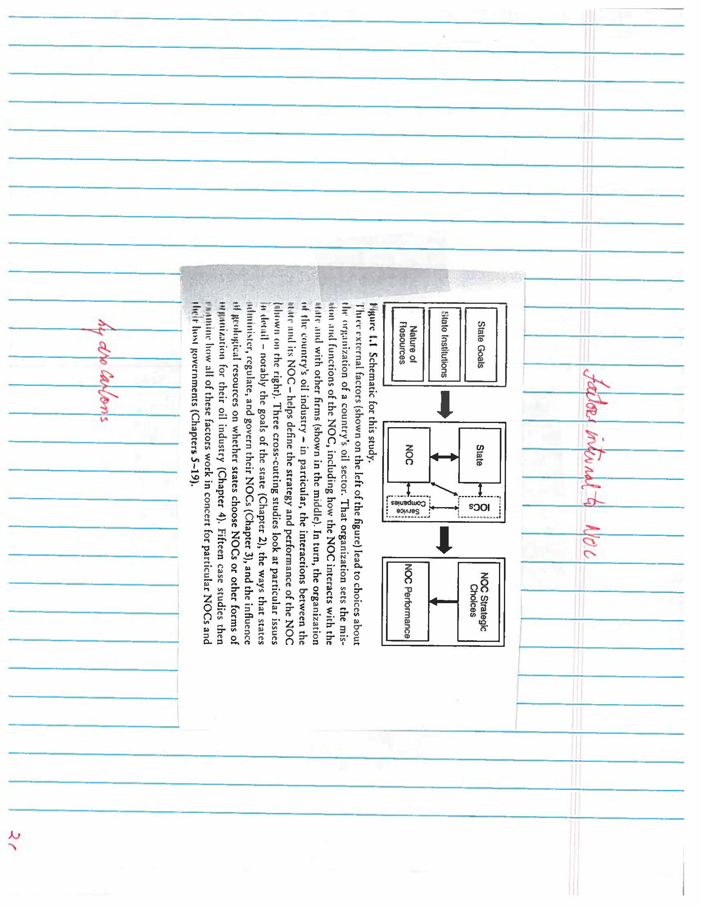
Factors Internal to NOC

Slide 7
Working Interest Productions
-See Chart 3
-Begs question - It private oil companies usually perform so much better than nationalized companies
-Why have so many countries nationalized private components and established state – owned petroleum companies?
-Why do they continue to maintain NOC’s in face of weak performers
-Based on study 15 countries

Slide 8
Incentives for expropriations
At NOC, gives state leaders greater autonomy
Channels investments and favored projects
Governments can assert stricter regulation on oil sector
Provides employment to political allies
Transfers output and physical asset ownership to host government
Constraints on expropriations
Leader must overcome political constraints of office
Few benefits with short term windfall

Slide 9
Questions
How do political incentives and constraints affect probability of expropriation and privatization in the oil sector?
Do these same factors affect both expropriation and privatization decisions?
Do these decisions vary overtime?
Is oil sector economy different from other industries?

Slide 10
Hybrid Governance
NOCs are hybrids - corporate governance
public administration
regulation
Are the leading state-owned enterprise Most often the largest domestic company
Produce the most rents (RENTS Excesses)

Slide 11
Hybrids
Differences:
-Sources of revenue
-Technocratic Expertise
-Clear lines of authority
-Control over budget
Common Threads:
-Most are a hybrid of corporate governance public administration regulation

Slide 12
Hybrids Hypotheses – Chapter 3
NOCs perform better in states that have unified control over the companies and worse in states that have fragmented control
NOCs performance is positively related to monitoring -heavy over-sight systems and negatively related to procedure -heavy systems
NOCs are higher performing when home states primarily rely on low casual systems to administer them and worse when informal mechanisms

Slide 13
Exploration Uncertainties
A commercial petroleum system (play) has components of
A source rock with rich carbon content
A sedimentary reservoir rock to hold volumes
A non pervious sedimentary rock that can be a barrier
A structural trapping mechanism
A fortuitous geological timing

Slide 14
USGS World Petroleum Reassessment
937 geological provinces in globe
406 found petroleum
78% of petroleum outside US is only 20 geological provinces
50% in five

Slide 15
Frontier Development Uncertainties
Significant Technical uncertainties;
Reservoir rock fluids, porosity, permeability
Faults and fractures restricting flows
Oil on gas is complex mixture
Viscosity
Impurities
Pressure and temperature
Aquifer
Production storage
Secondary and testing recovery
All affect future costs

Slide 16
Exploration Risk
A new “play” in process of predicting presence characteristics and location the center of the exploration business
Geological models can be constructed to predict favorable combinations of source reservoir and sealing rocks

Slide 17
Managing Exploration Risk
Observation, modeling and prediction of what cannot be observed directly
Well and seismic data – inform exploration
-Use of remote tools
-Cores of rock
-Stratigraphic data on rocks and relationship

Slide 18
Managing Field Development
Sampling and prediction
Objective is to reduce uncertainties
Change to estimates of recoverable reserves
Wells will be designed and sited to recover petroleum in most economically efficient manner
Reserves

Slide 19
Company Type and Capacity
Three Broad Categories
-Privately owned IOC’s
-State – owned NOC’s
-Various OSC that provide technical sources
Any company is theoretically capable of pursuing any risk management strategy

Slide 20
International Oil Companies
-Focused exclusively on profit maximization
-Most succeed in competition
-Most promise value to petroleum state
-Must be able to predict more value than other
-Must “see” what other cannot
-More in – place
-greater recovery potential
-Future technologies to reduce cost right?
-Get it’s predictions right

Slide 21
IOC’s
-Driven by commercial incentives
-Increase profits by innovating engineering solution
-Develop a global portfolio of ventures
-Ability to mitigate market availability risk?
NOCS
-Can also attract private capital
-Connecting supply to demand around the globe

Slide 22
Conclusion
Private or state operating -
Decision defined by three variables;
The petroleum states motive for direct control through a state company
The interest risk in doing so
The capacity of the state to take on these risks

Slide 23
Industry Structure
Large share of worlds petroleum reserves under control of state companies- 70+ %
Some argue that days of private operating companies are over
State companies and oil services companies will increasingly control
writers are skeptical
OSC do not compete with private operating companies (oil service companies)
Most state companies are not well equipped to manage extreme risks
There will remain a new high-risk frontier to be conquered as long as there is a petroleum industry
Concluding that:
The role for private operating companies in the petroleum industry will not disappear
State Companies will continue to thrive where there are low – risk and low cost hydrocarbons to manage

Slide 24
Table 1

Slide 25
Table 2

Slide 26
Table 3

Slide 27
Table 4

